Slide 1

Crop Production
Analysis In India
Year 1997 -2015
Presented by Mr Bhupesh

Slide 2
Content
Introduction
Objective
Main KPIs
My Design
Dashboard with Video formatting
Technology Use
Conclusion

Slide 3
Introduction
Agricultural economics began in the 19th century as a way to apply economic priniciples
and research methods to crop production and livestock management .
Crop production is a branch of agriculture that deals with growing crops for use as food
and fiber .
Crop production includes grains ,cotton ,tobacco ,fruits ,vegetables ,nuts and plants.
All living organisms require food .

Slide 4
Objective
The Agriculture business domain, as a vital part of the overall supply chain, is expected to
highly evolve in the upcoming years via the developments, which are taking place on the
side of the Future Internet. This paper presents a novel Business-to-Business collaboration
platform from the agri -food sector perspective, which aims to facilitate the collaboration of numerous stakeholders belonging to associated business domains, in an effective and flexible manner.
This dataset provides a huge amount of information on crop production in India
ranging from several years. Based on the Information the ultimate goal would be to
predict crop production and find important insights highlighting key indicators and
metrics that influence crop production.

Slide 5
Main KPIs
Total Production : Sum of all Crop
Highest Production State : Growth of Crop Production by state

Slide 6
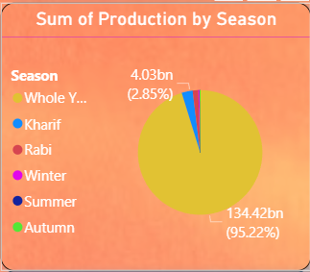

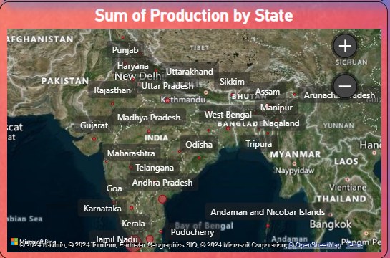
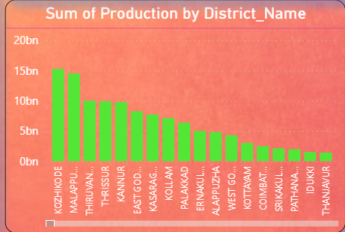
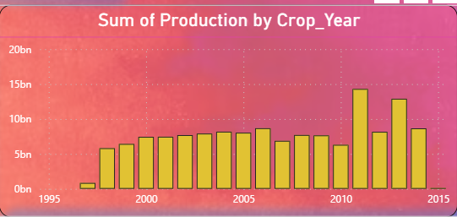
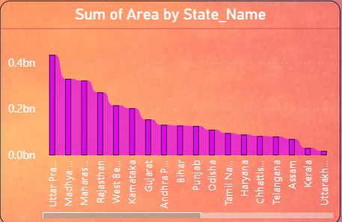
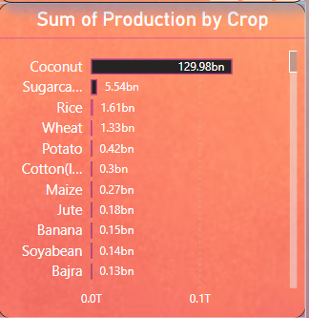
My Design
We can determine Specific Season and Year by Slicer
We can determine Sum of Production by State With Map
We can determine Sum of Production by district_name with Clustered Column Chart
We can determine Sum of Production by District Name with Clustered Column Chart
We can determine Sum of Production by Crop_Year with Clustered Column Chart
We can determine Sum of Area by State_name with Ribbon Chart
We can determine Sum of Production by Crop With Clustered Bar Chart

Slide 7
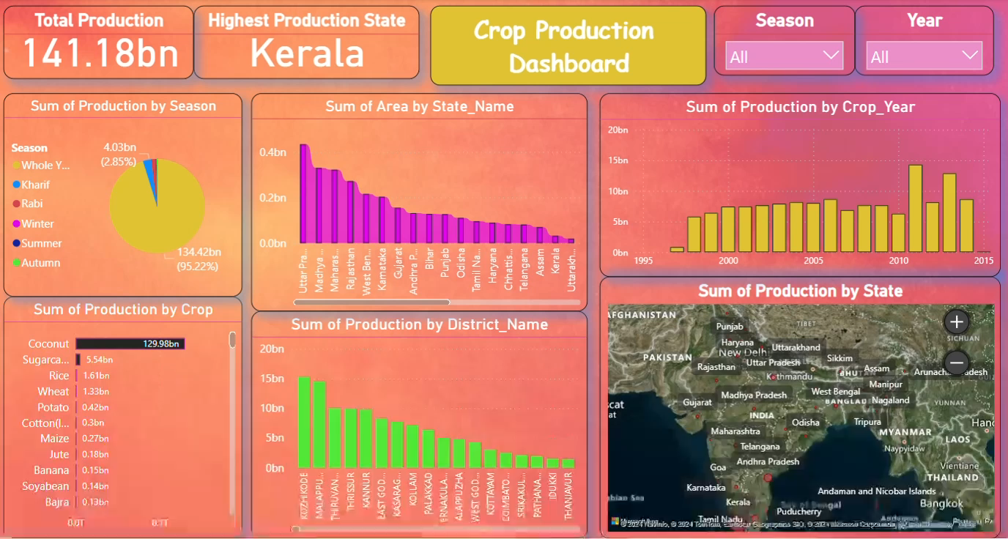
Dashboard with Video Formatting

Slide 8
Tool and Technology Use
In this project I will use Power BI Tools
Power BI is a powerful business intelligence tool developed by Microsoft
This tools easily to use ,Data Visualization , Data Connectivity And Cost Savings.

Slide 9
Conclusion
Crop production is more nutrient efficient than extensive methods requiring less cropland and fewer animals for the same output .The agriculture industry faces challenges from urbanization and technological advancements , impacting soil quality and labor availability.
To enhance crop production ,research on soil , water ,and nutrient management in underdeveloped countries is essential.
Preserving agricultural land is crucial for smart growth , balancing urban expansion with maintaining a healthy agricultural base .
The future prospects of crop production are influenced by various factors such as climate conditions ,soil quality ,
Technology advancements , and government policies .
To meet the increasing global food demand ,estimates suggest a need to increase food production by up to 68% by 2050 , driven by factors like population growth and changing dietary preferences.
Increase Crop Production technology include precision Agriculture ,Industrial Automation ,Remote Monitoring with
Sensors, Smart Farming Technologies .
These technologies are transforming agriculture by increasing efficiency , sustainability , and productivity while
Addressing challenges like labor shortages and environmental impact .

Slide 10
Thank
you!

